Slide 1

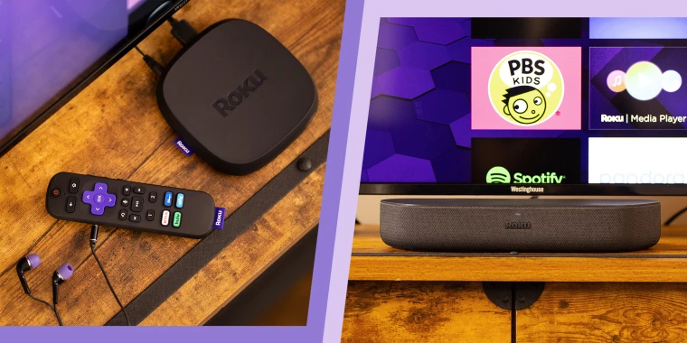
Roku User Review
Analysis:
Does product upgrade improve user experience?
Team 11
Heran Bai, Shauna Han, Megan Reddy, Yachen Xiao, Shucen Yu, Shengkang Zhou

Slide 2
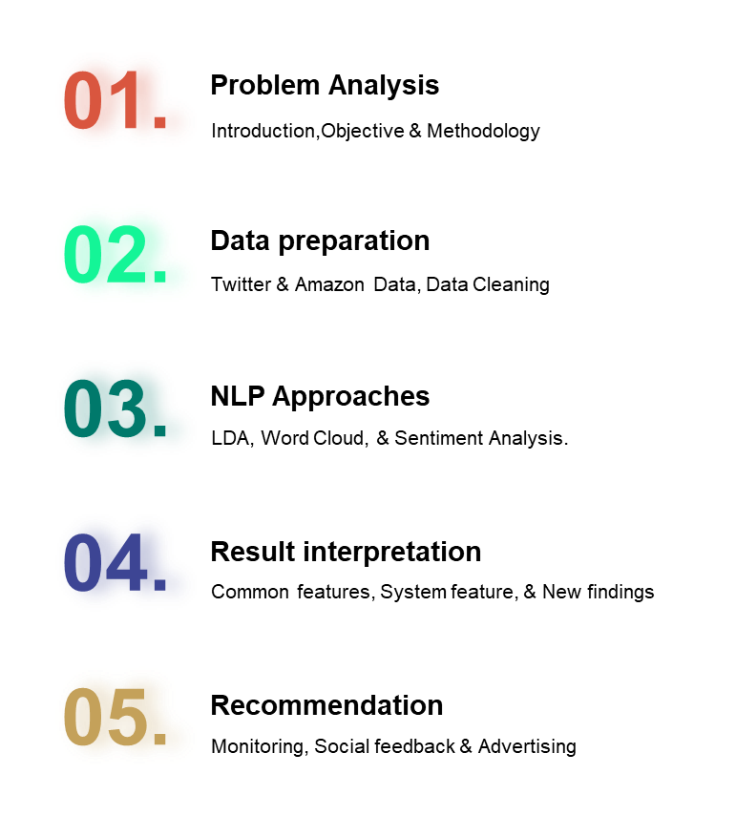


Slide 3


Problem Analysis
What is Roku?
A digital media player
Stream media content from the internet to TV
The first Roku model was developed in collaboration with Netflix.
Project Objective
Identify what users like and dislike about their Roku product
Offer suggestions for the next product development.
Methodology
We investigate the sentiment of Roku users for each upgraded version: OS 9.4, OS 10, and OS 10.5:
Visualization: Word Cloud
LDA topic modeling
Sentiment analysis
Text analysis

Slide 4


Data Preparation
Twitter Data
Used Twitter API platform to obtain tweets
Filtered location to the US
Obtained around 1K tweets for each OS version
Amazon Data
Used Rainforest API to extract user comments
Time: Sep, 2020 ~ Feb, 2022
Mean Number of Words per Reviews: 65
Data Cleaning
Deleting special character and numbers
Limit the length of comments
Excluding stopwords & Non-English words
Stemming
Combining Twitter and Amazon

Slide 5

NLP Approaches I: LDA Topic Modeling
What is LDA? Finding latent topics by calculating how far each words are with each other. Closer words form a topic.
Goal: To maximize CV coherence score while keeping the topics interpretable.
Measurement: CV coherence score
Limitations:
1. CV coherence score might not be a robust measure
2. Twitter not dropping potential advertisement
3. Optimization
I
II
Fetch Bi & Tri gram
Corpus & Dictionary
Select Mono, Bi, and
Trigram to run LDA
Create Corpus and Dictionary for
LDA usage
IV
III
Drop new Stop words
Number of Topics
Set the numbers of topics and run LDA, recording the score
Define new meaningless words and drop them

Slide 6
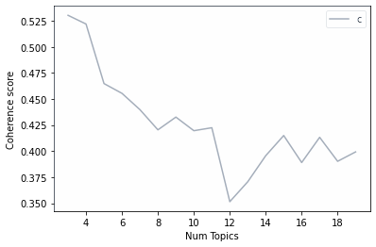
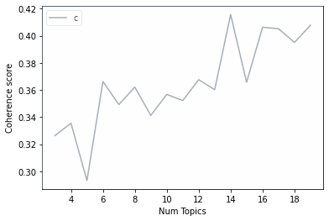
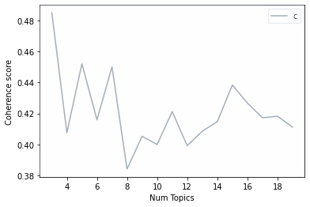
OS 9.4
LDA Result:
OS 9.4
Coherence Score Table
 | Amazon | Twitter | Combined
OS 9.4 | 0.3128 (# topics= 4) | 0.3027 (# topics= 3) | 0.5225 (# topics= 3)
OS 10.0 | 0.3215 (# topics= 14) | 0.3191 (# topics= 12) | 0.3593 (# topics= 14)
OS 10.5 | 0.4052 (# topics= 5) | 0.2743 (# topics= 5) | 0.4319 (# topics= 3)
OS 10.0
OS 10.0
Combined Dataset Topics
 | OS 9.4 | OS 10.0 | OS 10.5
T1 | stream/pictur/support/atmo | watch/stream/channel/live | watch/steam/channel/live
T2 | remot/stream/replac/unit | get/remot/love/stream | remot/great/day/good
T3 | app/remot/watch/fire | work/like/remot/app | stream/devic/connect/issu
T4 |  | work/stream/get/remot
T5 |  | remot/stream/watch/apl
OS 10.5

Slide 7
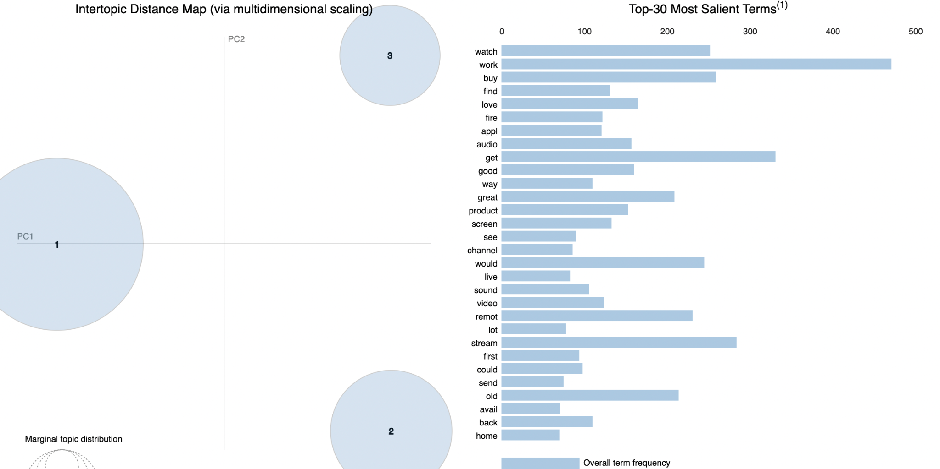
Intertopic Distance Interactive Map and Top 30 Salient Terms
OS 9.4 :
“pyLDAvis” is a python library for interactive topic model visualization.
pyLDAvis shows the following:
Distance between topics, as a map in 2D plane.
Variance in the topic-word distribution, as the size of a circle in this map.
the most salient terms in each topic.

Slide 8
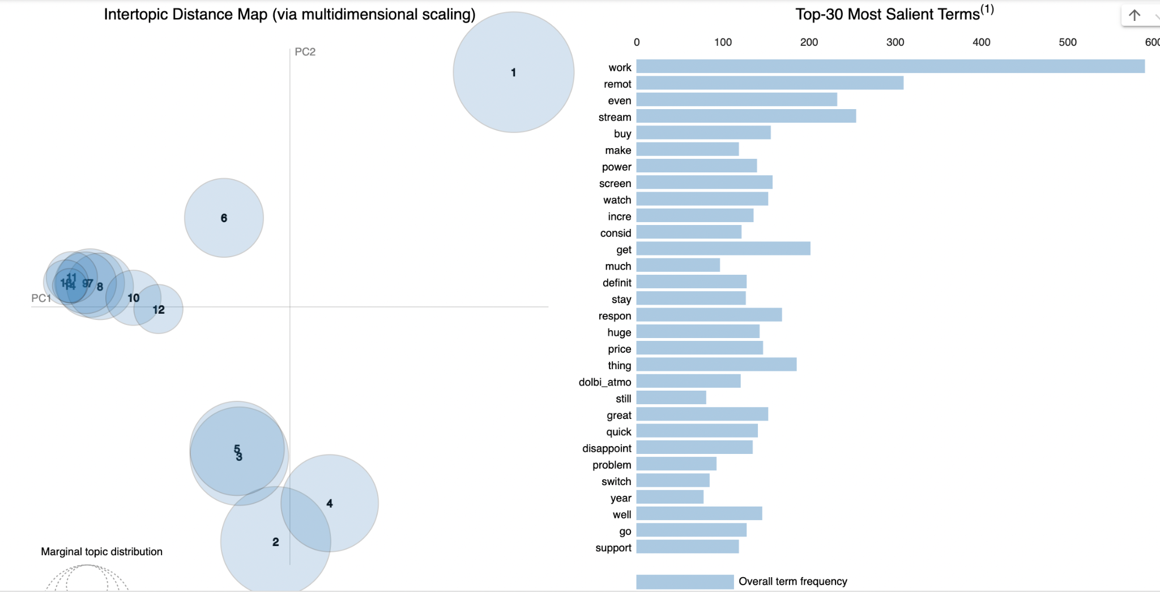
Intertopic Distance Interactive Map and Top 30 Salient Terms
OS 10.0 :
Topics 1 and 6 are the most separated, while remaining topics are similar to one another

Slide 9
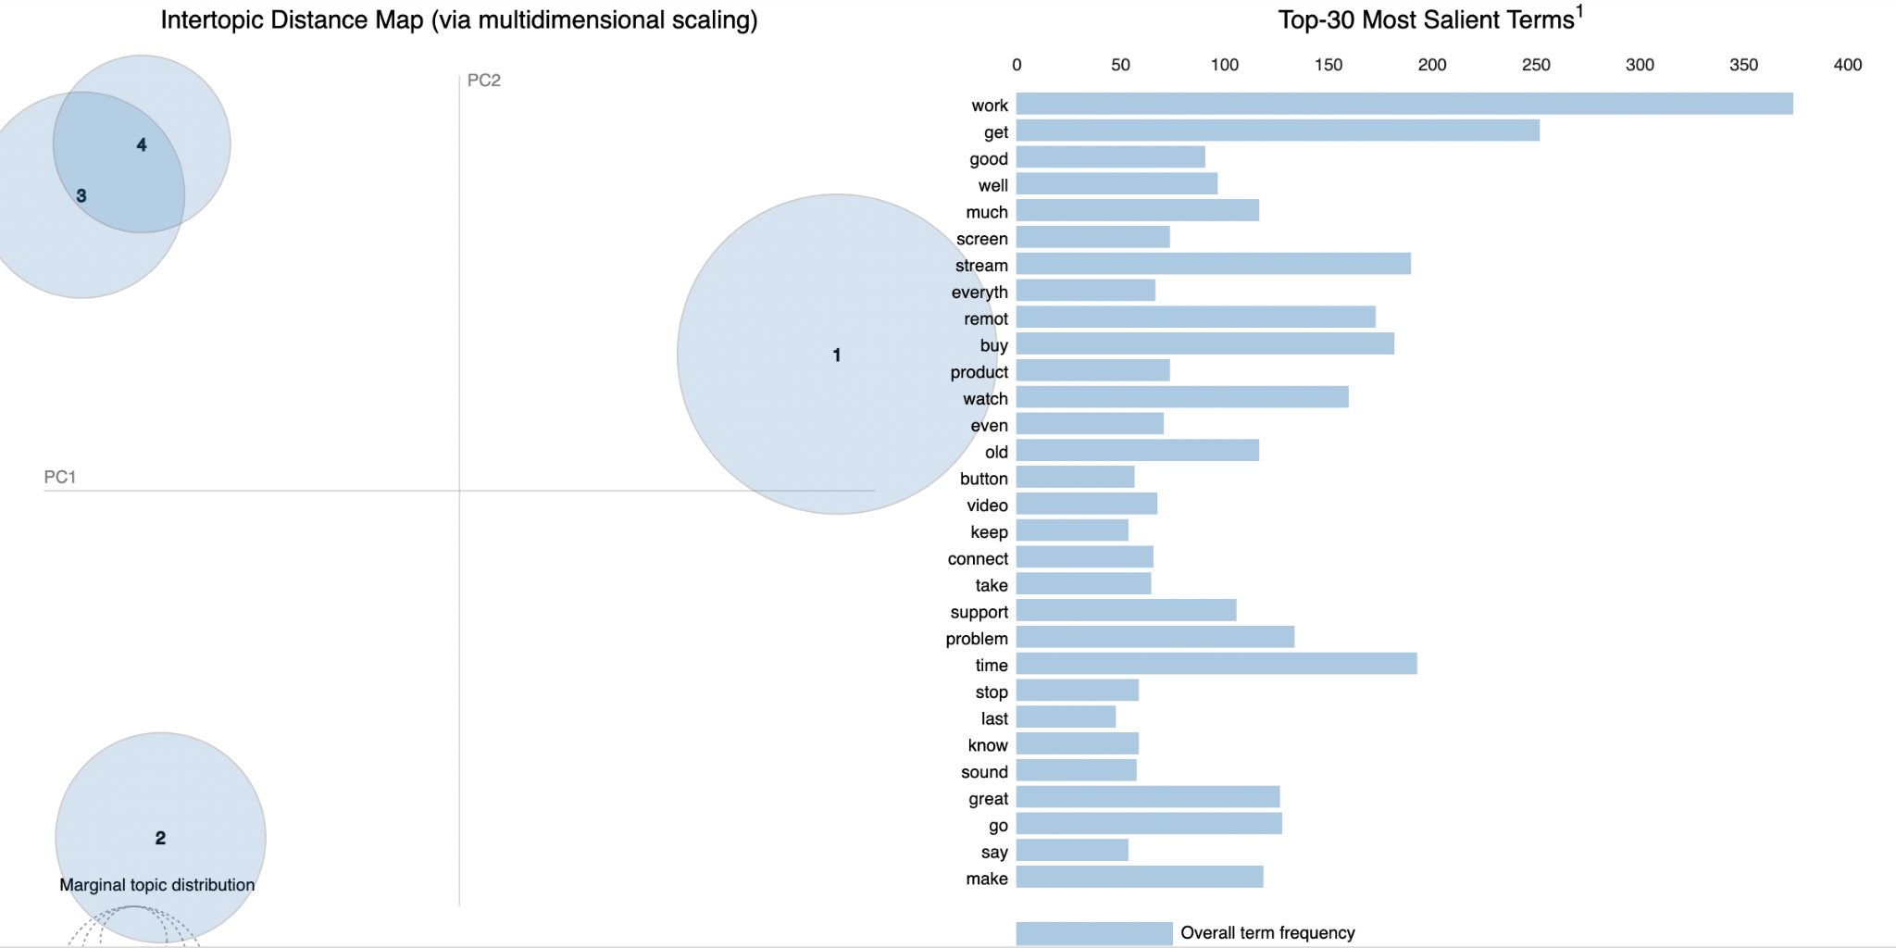
Intertopic Distance Interactive Map and Top 30 Salient Terms
OS 10.5 :

Slide 10
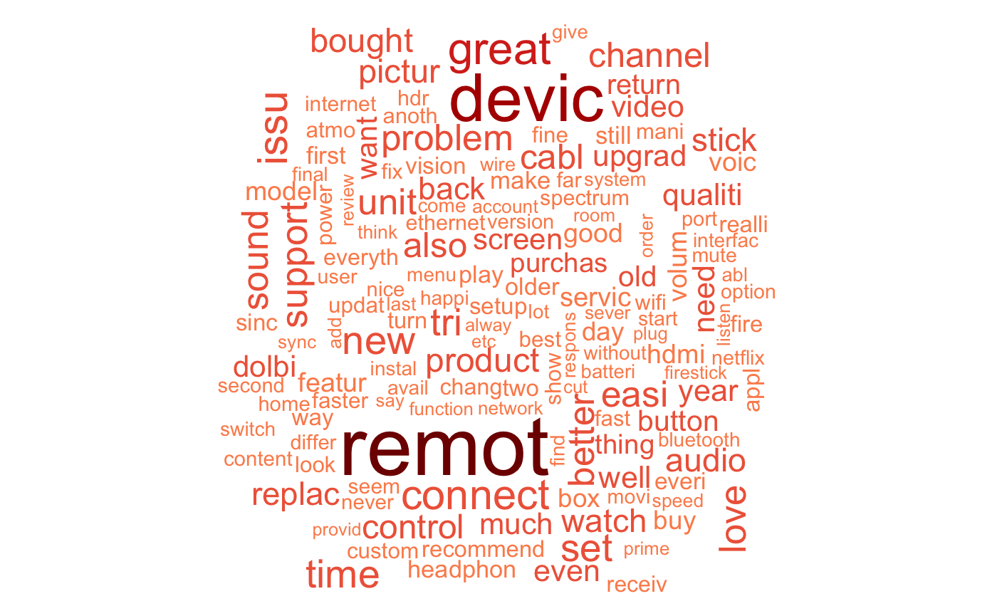
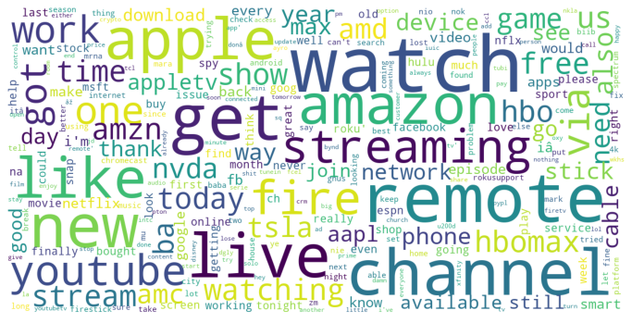
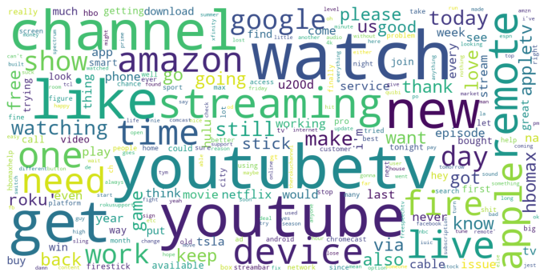
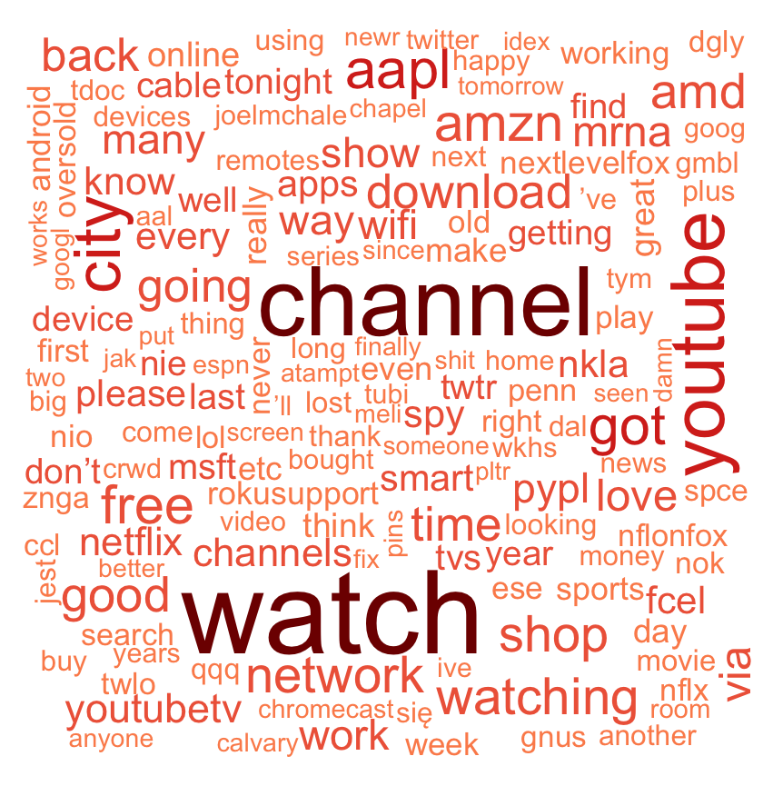
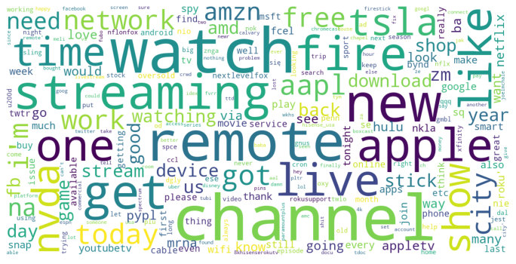
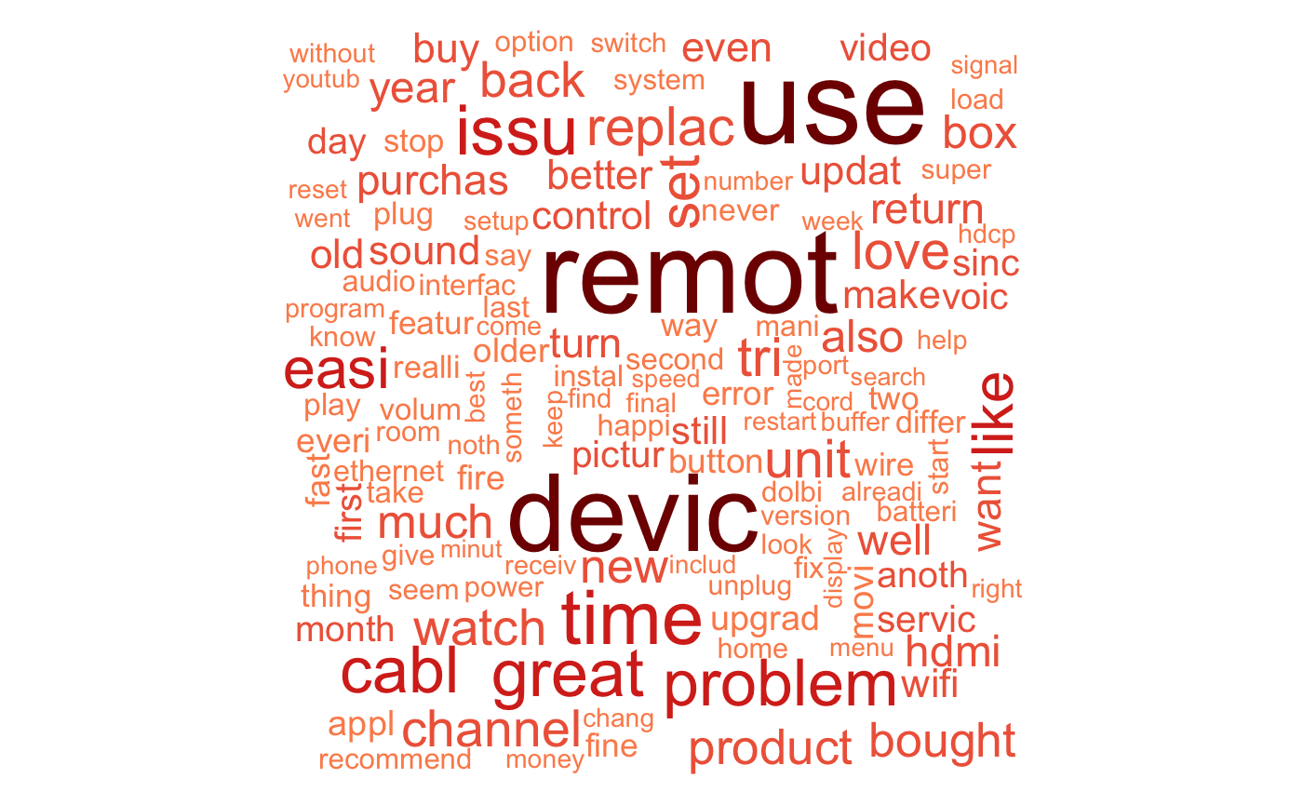
NLP Approaches Ⅱ
Tweets Word Cloud
Amazon Reviews Word Cloud
Word Cloud Visualizations
OS 9.4
Used Python inbuilt library to generate word cloud
Cleaned the dataset by filtering non-English words, removing URLs, and removing stop words
Frequent words are with bigger and bolder letters
OS 10.0
Results:
Overall, similar patterns of frequent words shown for both tweets and amazon reviews.
More brand names (ie. apple, amazon, google, etc) appeared in tweets than in Amazon reviews.
OS 10.5

Slide 11
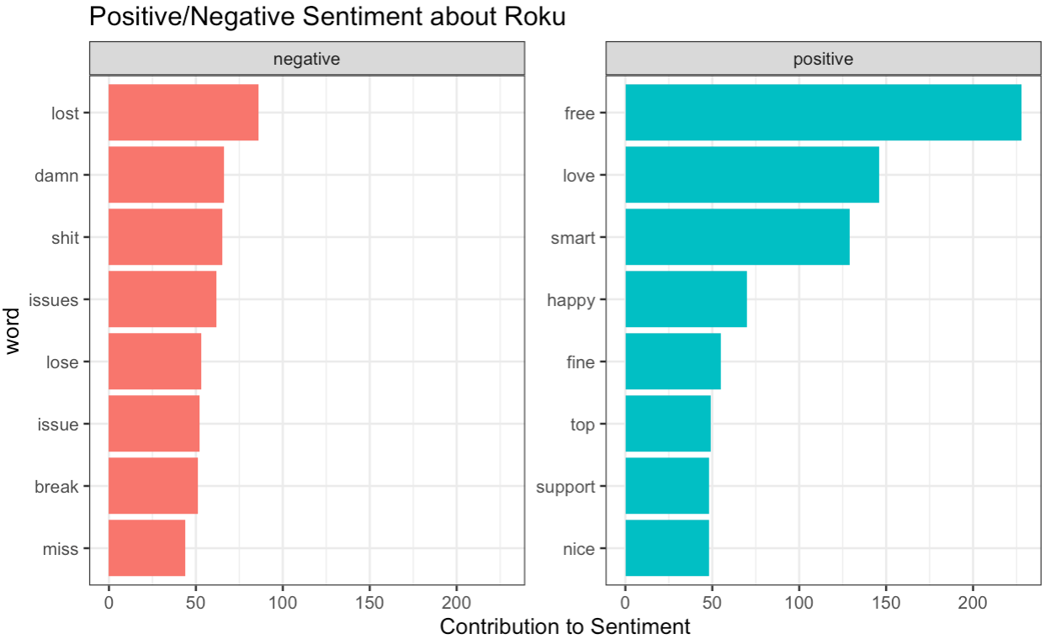
Global Positive and Negative Sentiments on Roku
* Global Sentiment Analysis on combined data (tweets and Amazon reviews) of three Roku OS versions all together
According to the analysis, it seems that the majority of consumers think positively about Roku products.

Slide 12
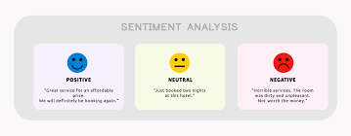

NLP Approaches Ⅲ
Sentiment Proofreading
Method:
For our sentiment analysis we used Hu and Bing 2004 dictionary
With each update we studied the change in sentiment score to identify a trend in the change in sentiment score over the 3 updates
Also studied the association between certain keywords and changes in sentiment
Implemented ANOVA test to see if the changes we observed were due to chance

Slide 13
Sentiment Result
Results showed that each update resulted in a decrease in the sentiment score.
Anova test results showed a p-value of <0.05 for each score indicating that the results were statistically significant.
Certain keywords such as “connect” and “battery” surfaced in LDA
We postulated that the reviews containing these keywords were more likely to be negative reviews.
We ran sentiment analysis which confirmed our hypothesis that these keywords were associated with negative reviews since the presence of these keywords in a review often resulted in a lower sentiment score.
Sentiment Change Over Updates
Keyword sentiment
 | Amazon | Twitter | Combined
OS 9.4 | 0.5532 | 0.4282 | 0.4705
OS 10 | 0.5504 | 0.3934 | 0.4542
OS 10.5 | 0.4742 | 0.3829 | 0.4103
p-value | 0.01 | 0.02 | 0.01
review with “connect” | review without “connect”
0.4210 | 0.4890
review with “battery” | review without “battery”
0.3581 | 0.4857
alpha=0.05, two-tailed

Slide 14

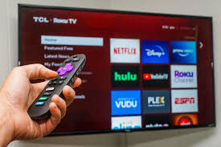
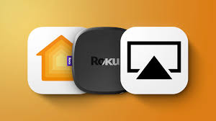
Common features with frequently update
Result Interpretation
Version | Amazon | Twitter | Combined
OS 9.4 | Roku device with their voice remotely using the Home app and Siri on iPhone, iPad, Mac, Apple Watch, or HomePod | All Roku devices provide easy access to watch free TV, live news, sports, movies, and more. | Not Founded
OS 10.0 | Live TV offers easy access to cable alternatives, including Hulu + Live TV, fuboTV, Philo, Sling, and YouTube TV | All Roku devices provide easy access to watch free TV, live news, sports, movies, and more | Not Founded
OS 10.5 | The Home tab provides easy access to the latest entertainment and channels, and offers a new way to explore Zones | More access to streaming live TV (U.S.) | Roku TV users have quick and easy access to live TV Roku Voice Remote Pro owners will also get tips on using hands-free voice

Slide 15
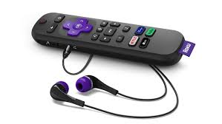
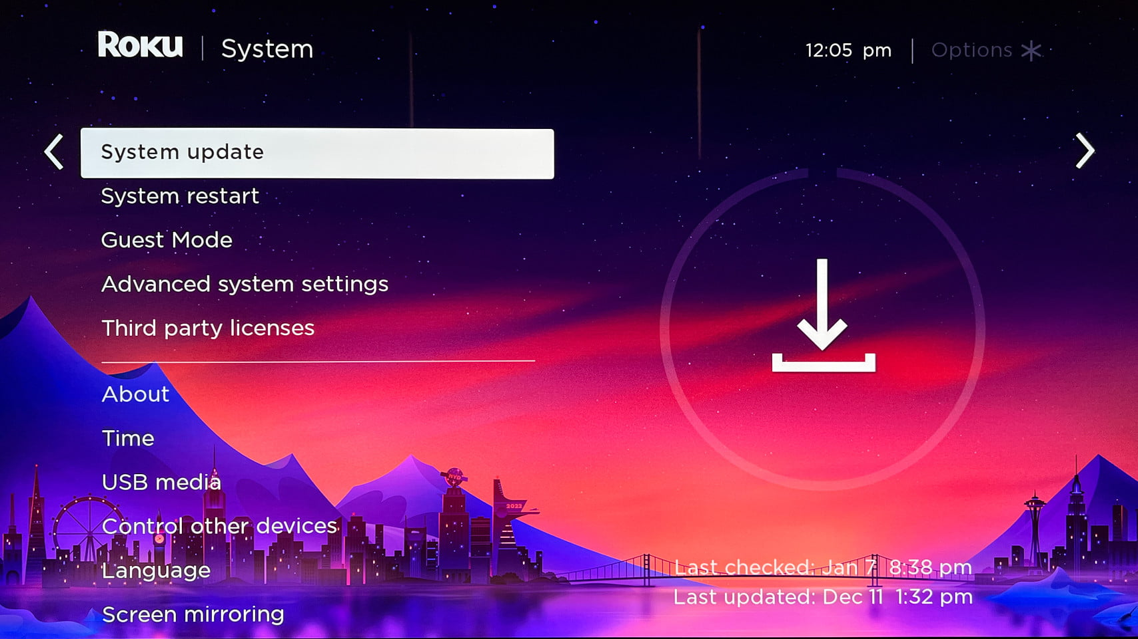
System and Hardware Connection Upgrade
Version | Amazon | Twitter | Combined
OS 9.4 | Many people have the issue of the remote doesn’t work even if they reset the device, so they have to open the app to control ROKU, which is annoying | Roku TVs let you access free live broadcast TV using your home’s antenna | Often compared with apple TV
OS 10.0 | The earbud option of the remote uses up battery really quick | Not Founded | Not Founded
OS 10.5 | Ruku able to combined in many ways to best suit your home setup speaker | Improvements to the Roku mobile app Users will experience faster channel launch. | Not Founded

Slide 16
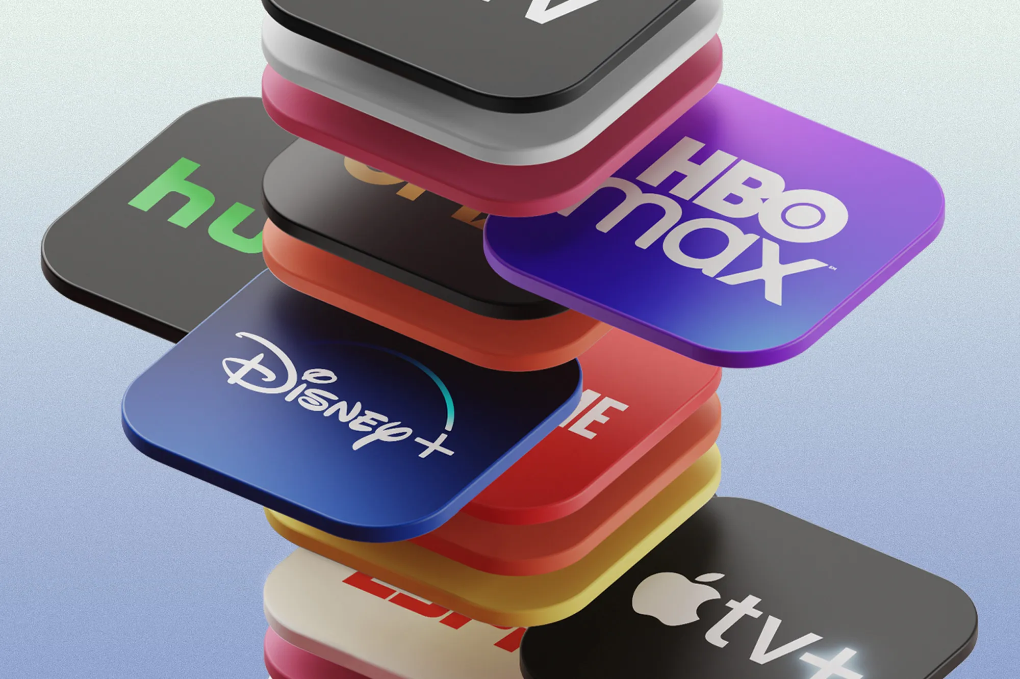
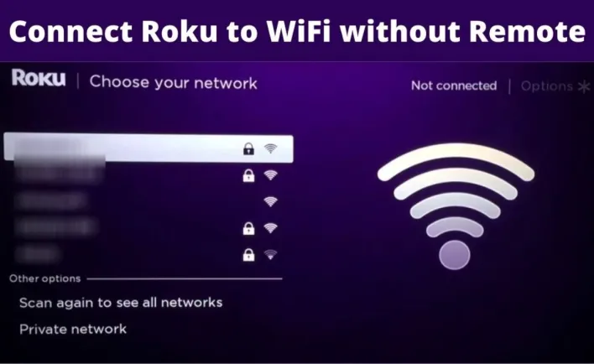
New features and contents
Version | Amazon | Twitter | Combined
OS 9.4 | Often compared with fire TV stick | Often compared with fire TV stick | Often compared with fire TV stick
OS 10.0 | Support better Wifi connection Rich and immersive sound experience with the new Virtual Surround setting | Consumer Bought it to watch the nanny Join the club to watch a show | Not Founded
OS 10.5 | Automatic Wi-Fi® network detection technology ensure smooth streaming experiences for Roku users Brings exciting new interactive features, full surround sound capability | Live TV also offers easy access to cable alternatives, including Hulu + Live TV, fuboTV, Philo, Sling, and YouTube TV | Not Founded

Slide 17
Conclusion
Our finding is parallel with our assumption that Roku’s frequent software update contributed to enhanced user experience.
→ While there were negative sentiments expressed by users concerning “issues”, “break”, “miss”, the overall user experience seemed very positive.
→ According to our sentiment analysis, while each OS update resulted in a decrease in the sentiment score, the overall score was positive, which again confirms our assumption that software update contributes to enhanced user experience.
According to the amazon reviews analysis, the keys for Roku’s success can be attributed to:
Easy access to different cable alternatives and shows
Automatic switch wifi to provide better streaming experiences
Voice control functions and good sound system experience
We observed that there are unresolved issues with Roku software; in the reviews, people complained about the remote control not working even when they reset the device, and about the short-lived battery for the remote earbuds option.

Slide 18
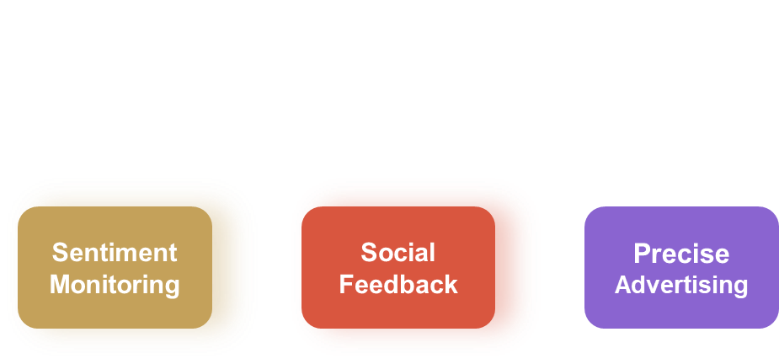
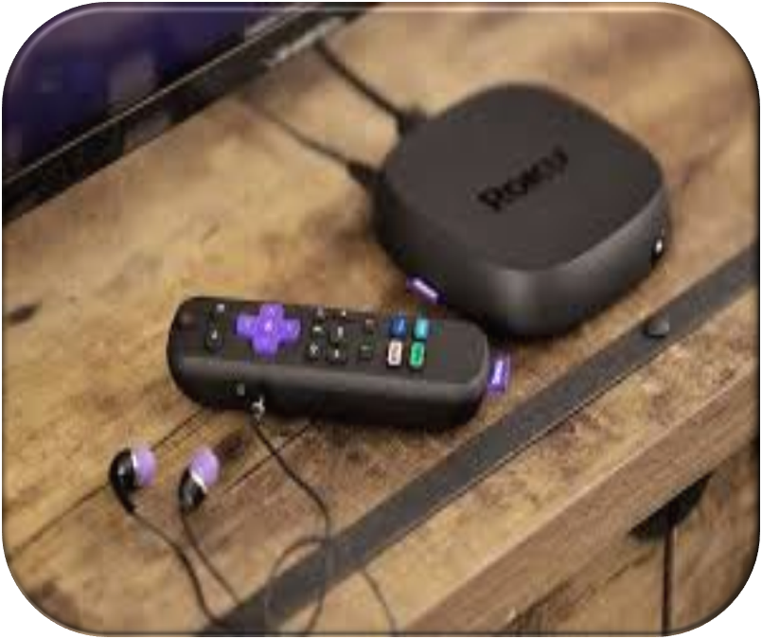

Recommendation
We recommend the company to apply the NLP process for:
A general idea on how the customers/ netizen’s sentiment fluctuate
A pre-stage understanding about bugs or features that customers like before digging into each comments manually
Precisely put advertisements targeting features that a platform care more about

